Slide 1

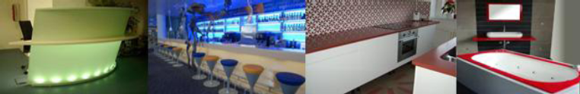

Slide 2

Watt is Corralit ?
Corralit is an original solid material with an excellent surface produced by VAGNERPLAST.
It is a sophisticated blend of natural minerals and pure acrylic, quite strong and solid, durable, hygienic and non-porous surface.
Corralit has a wide range of color, You can create creative desktops without any visible connections and joints. They can be color coordinated with the kitchen sinks and bathroom
sinks, or vice versa, in contrast with them.
Corralit ® is widely used by many designers, architects, furniture manufacturers, kitchen and also in the health sector. It can be used as applications for both indoor and outdoor use.
Corralit ® is heat-moulded thermoformable with guarantee of 15 years.
The product is manufactured, installed and used in accordance with the General principles and requirements of Vagnerplast-Corralit ®
.Corralit ® TL – awarded Czech patent. This synthetic stone is highly translucent and enables the creation of products which will permit the extraordinary mutual combination between the light, shape, colour and strength.
This material is adjustable and thermoformable to 160 ◦
Translucency and luminescence Corralit give you the freedom of imagination to use unlimited, purity and brilliance and high translucence allows even extraordinary, in-depth, three-dimensional effect, bringing a strong surround effect internal matter and allows you to stand out its complex structure.
Corralit ® ART is a unique shape created by mixing different colors and shapes created according to your own imagination.Changing the intensity of the light beams provides a large number of variants and arts. Architects and designers can take advantage of using their own design and art by mixing different colors to create a special design .

Slide 3

FEATURES
Invisible connections
Non-porous
Shock resistant
Easily repairable
Heat moldable
Machined like wood
Hygienic
Resistant to most chemical product
Resistant to UV radiation
Easy to maintain
Gloss, matt finish
Permeable Light – TL Corralit
Luminous: reserve light when light off
Heat resistant

Slide 4
TYPES
CORRALIT® STONE
Used to create kitchen desktops, backs, cabinets, drawers...
CORRALIT® LUMINOUS
Syntetically stone light transparent.
CORRALIT®TL TRANSLUCENT
High luminous, gets a new dimension when lighted.
CORRALIT®TOSCANA
Appears like a stone mosaic.
CORRALIT®ART
The original image becomes abstract sculpture by light.
Thanks to its 100 percent health safety and durability a wide option to create from it anything.
For everything. Is flexible and it can be worked out as plastic or wood.

Slide 5
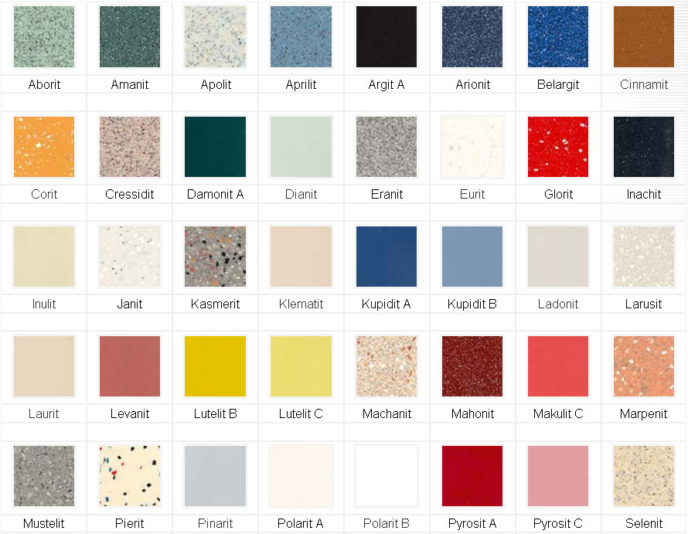
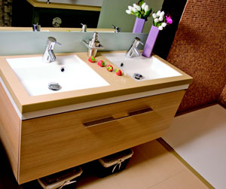
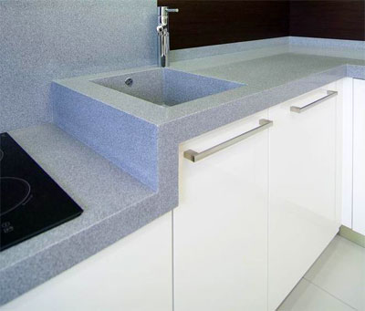
Corralit STONE
CORRALIT® stone SAMPLES
CORRALIT®ART

Slide 6
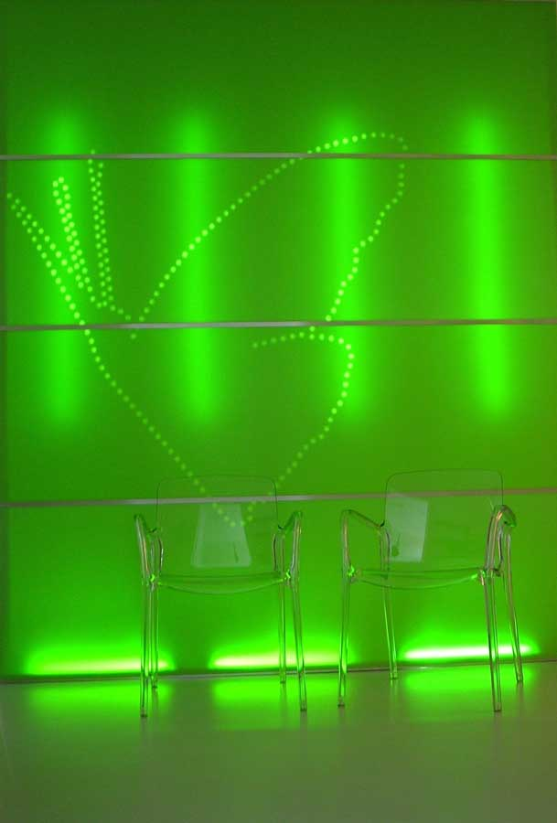
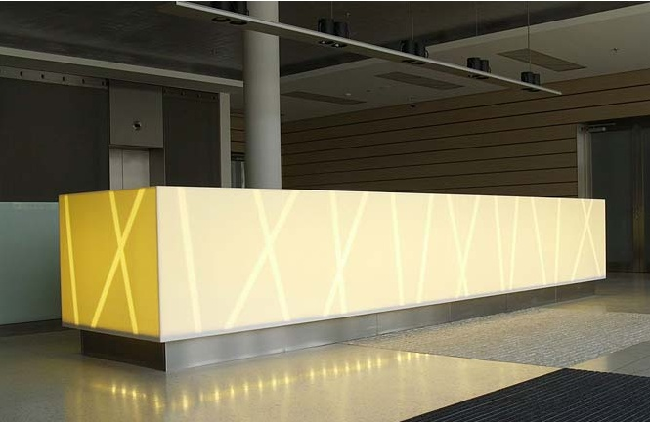
TRANSLUCENT
This synthetic stone is a highly transparent and allows
the production of special staffs, permitting mutual
combination between light, shape, color and strength.
Adjustable translucency translucence and luminescence
in conjunction with a luminous design promotes
imagination, a sense of freedom, purity and brilliance.
Surprisingly high transparency allows extra depth
three-dimensional effect that brings a light inside
the material and allows it to excel complex structure.
It has unusual interactive effect chips, color and design.

Slide 7
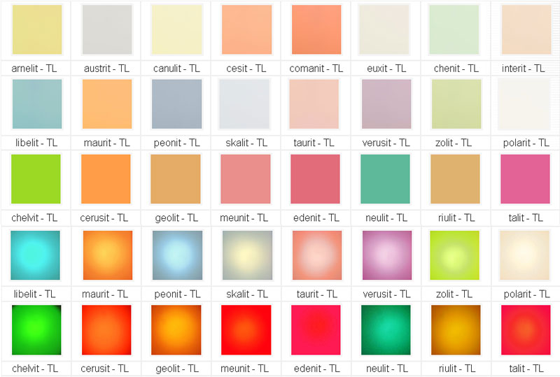
Corralit Translucent color samples

Slide 8
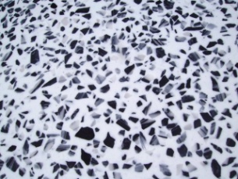
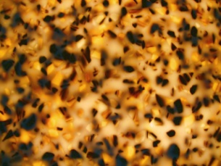
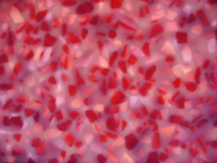
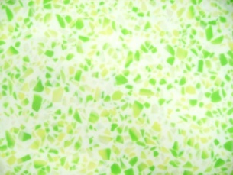
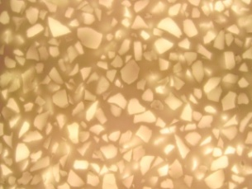
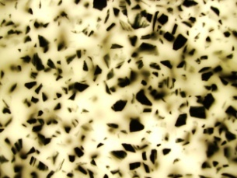
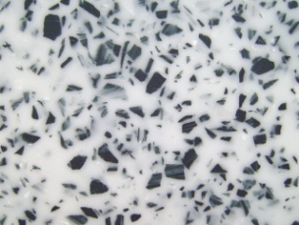
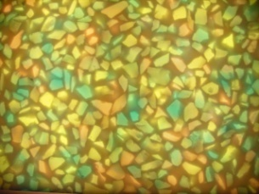
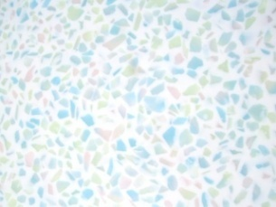
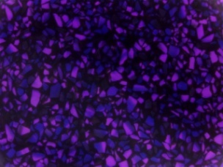
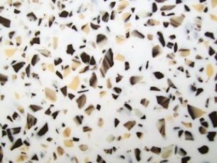
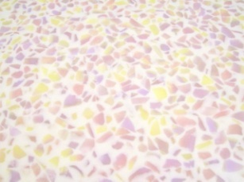
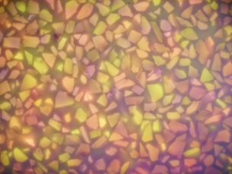
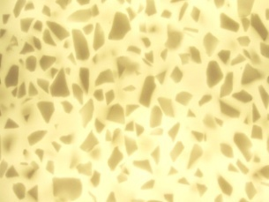
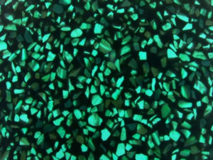
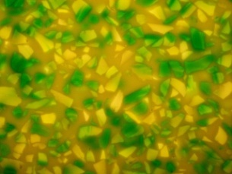
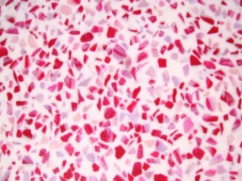
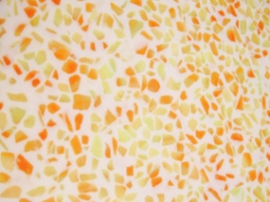
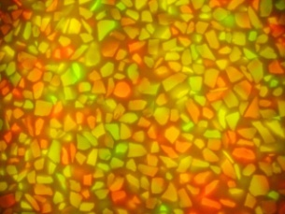

Toscana

Slide 9
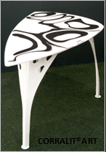
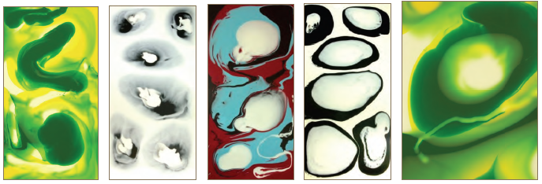
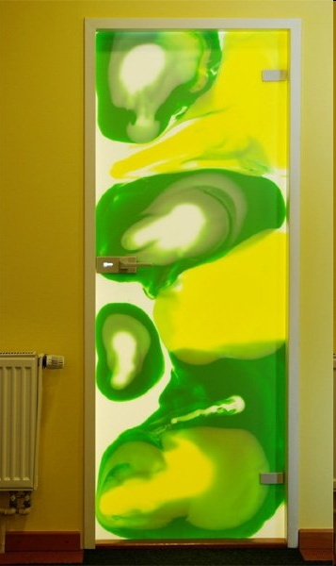
ART

Slide 10
THICKNESS
3mm
4mm
6mm
8mm
10mm
12mm
14mm
18mm
24mm
48mm
Warranty for all products
Garantee 15 years

Slide 11
uses
Bathroom – bath, shower trays, sinks, shower enclosures, shower panels.
Kitchen worktops, tiles, walls, dining dishes
Interiéry – reception, bars, lighting, wall cladding, doors, handrails, treads, etc.
Furniture – tables, cabinets, other decorative elements, paintings, graphics, sculptures,bathrooms (shower wall), Interior elements, etc.

Slide 12
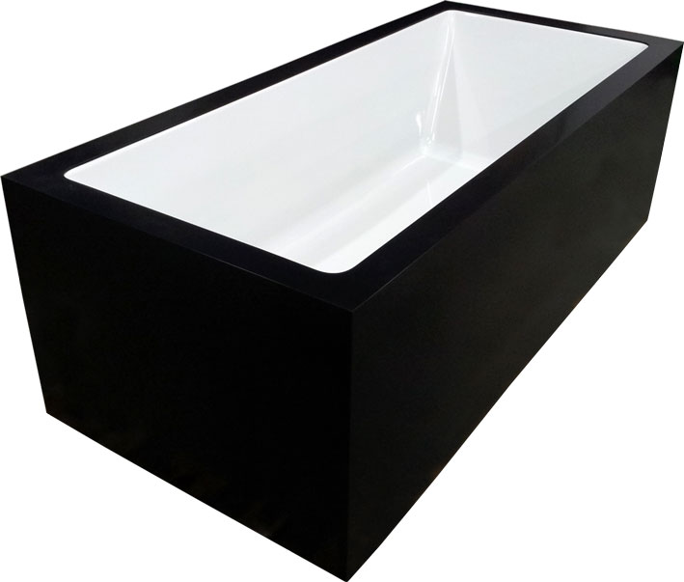
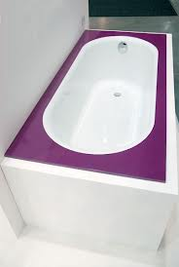
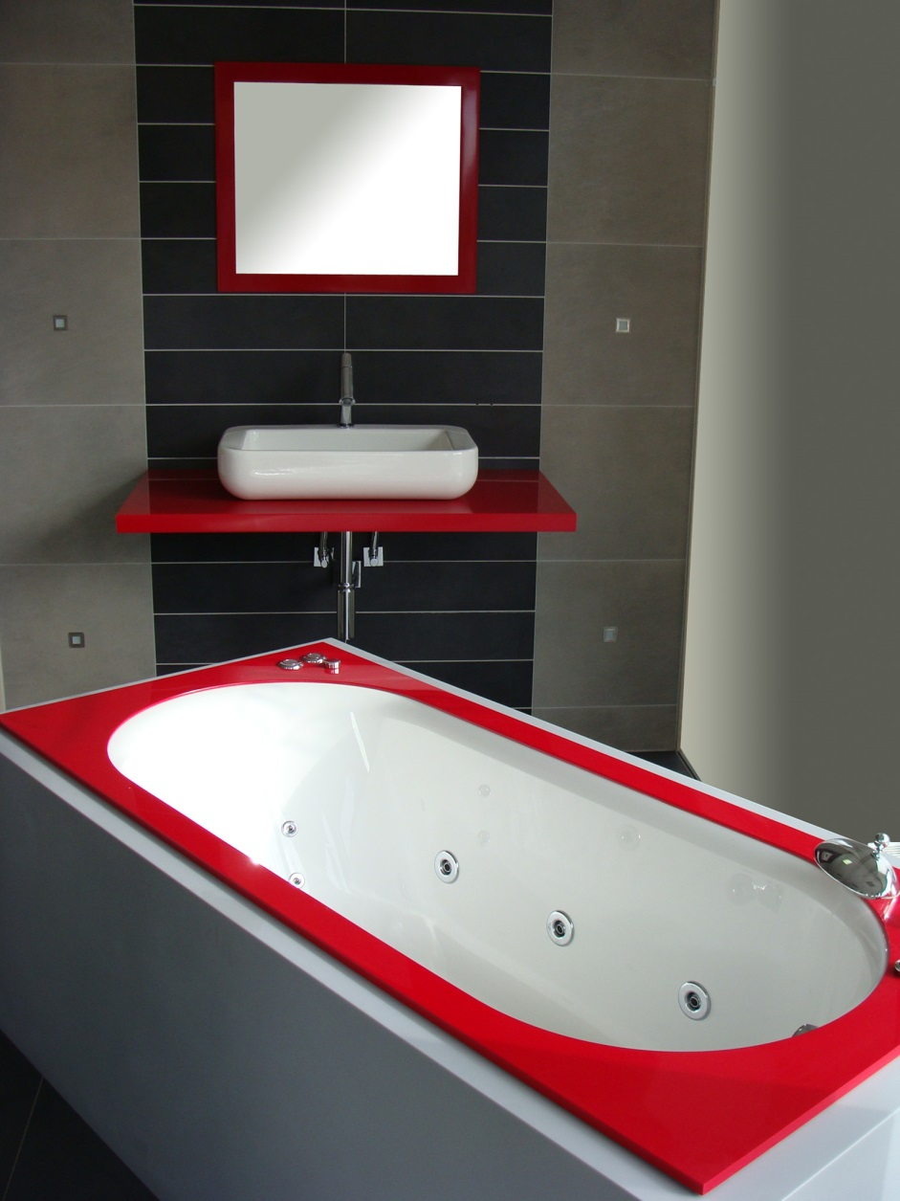
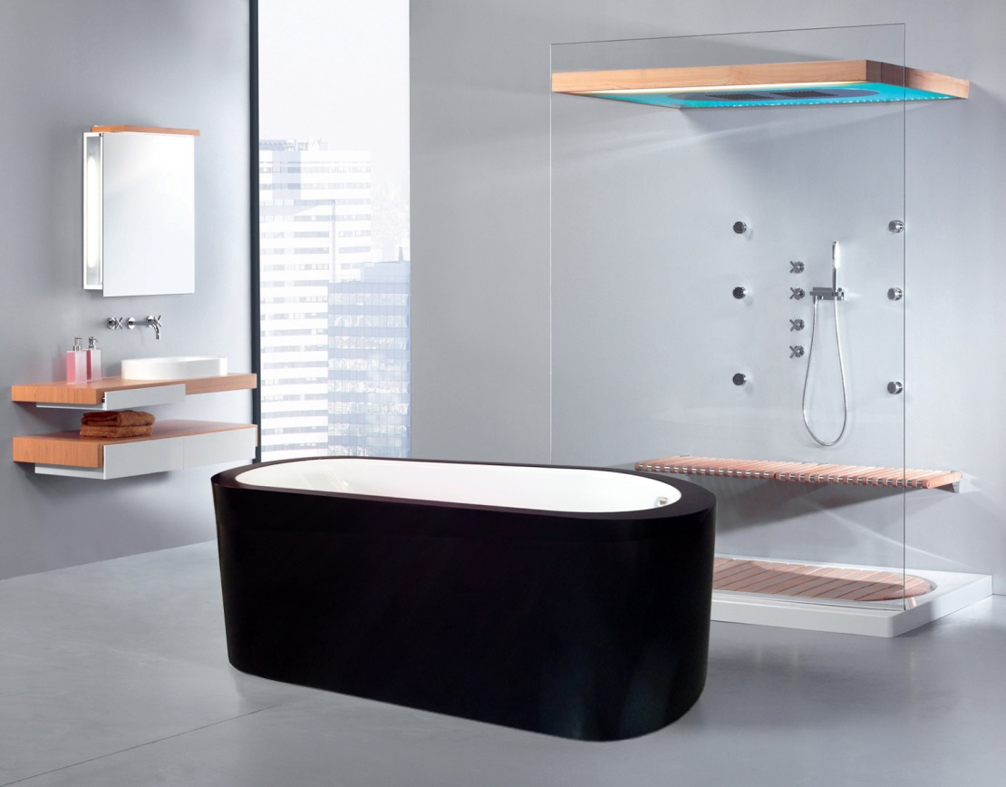
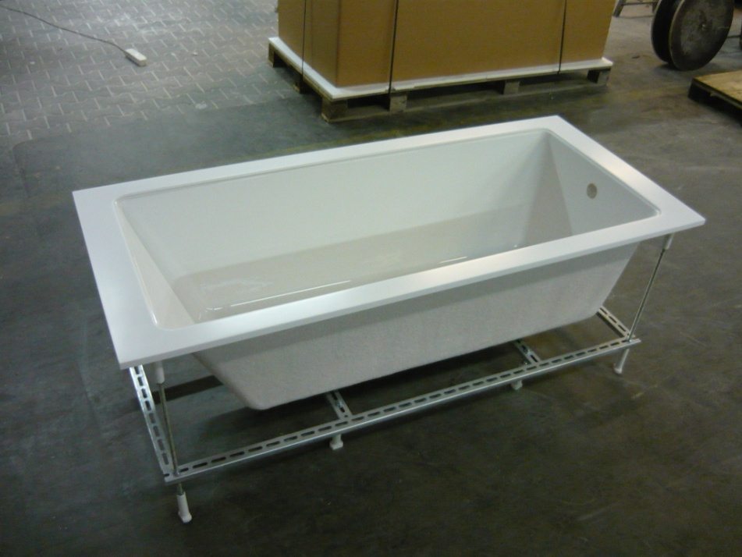
Bathtubs

Slide 13
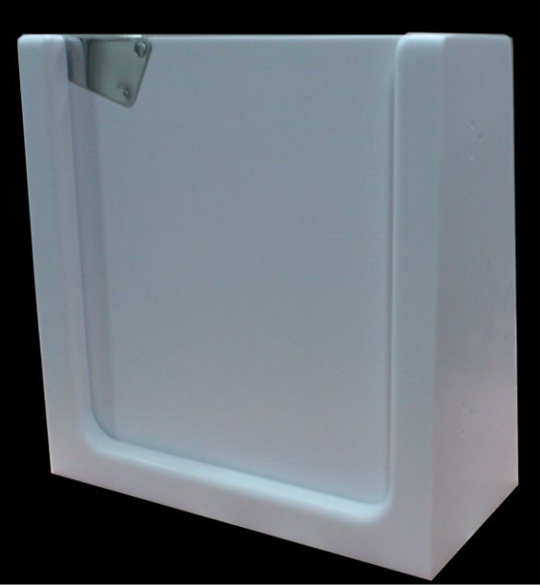
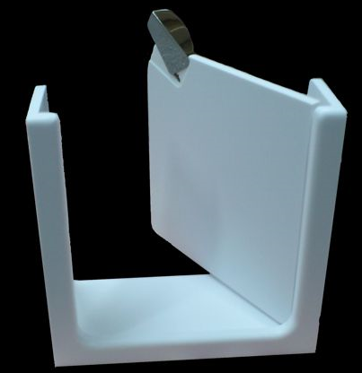
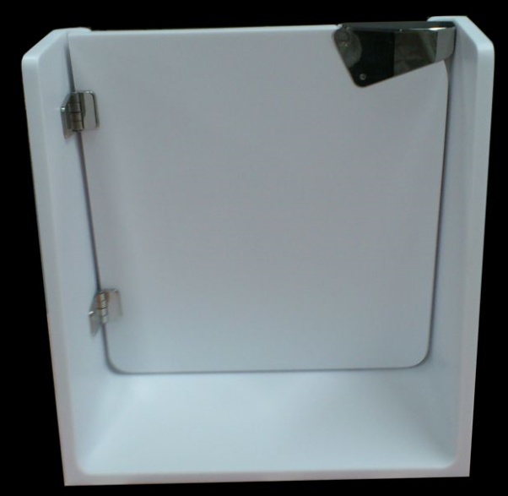
Bathtub doors

Slide 14
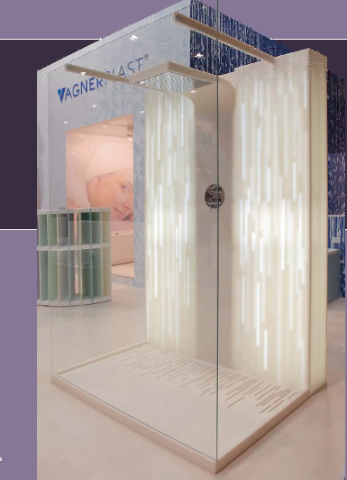
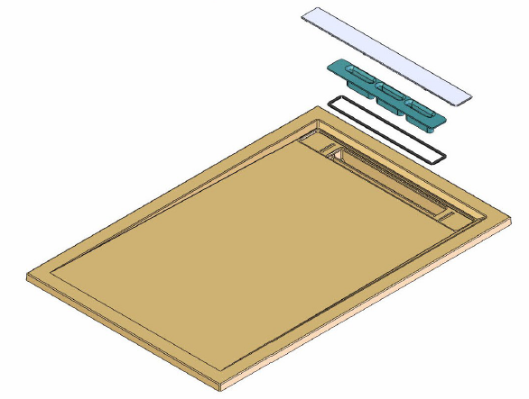
Shower box and trays

Slide 15
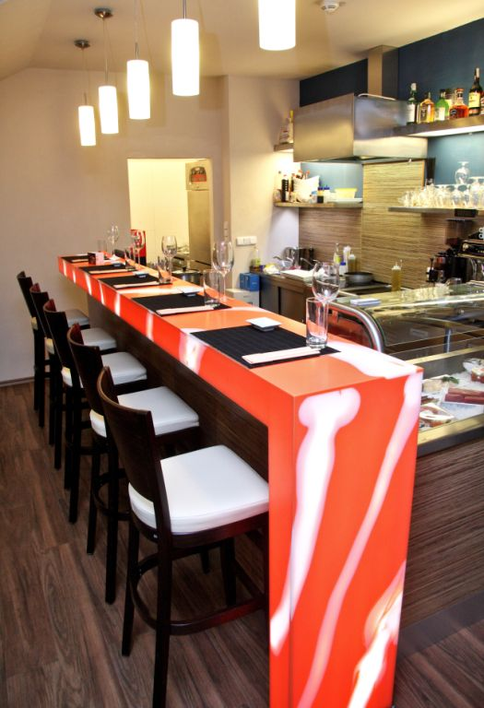
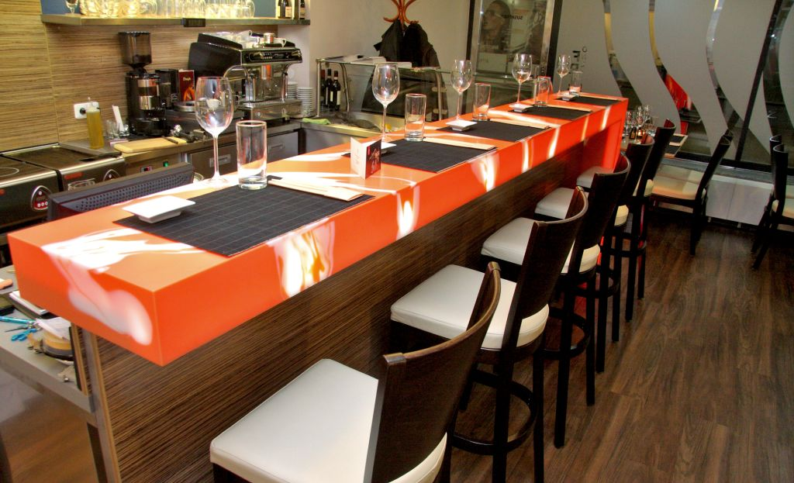
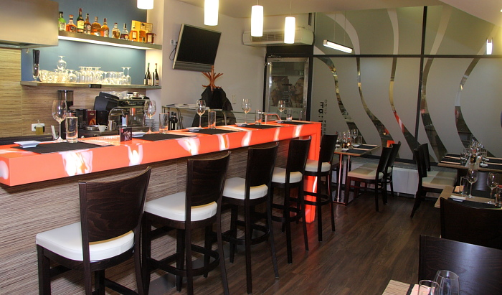
Gastronomy
Sushi bar

Slide 16
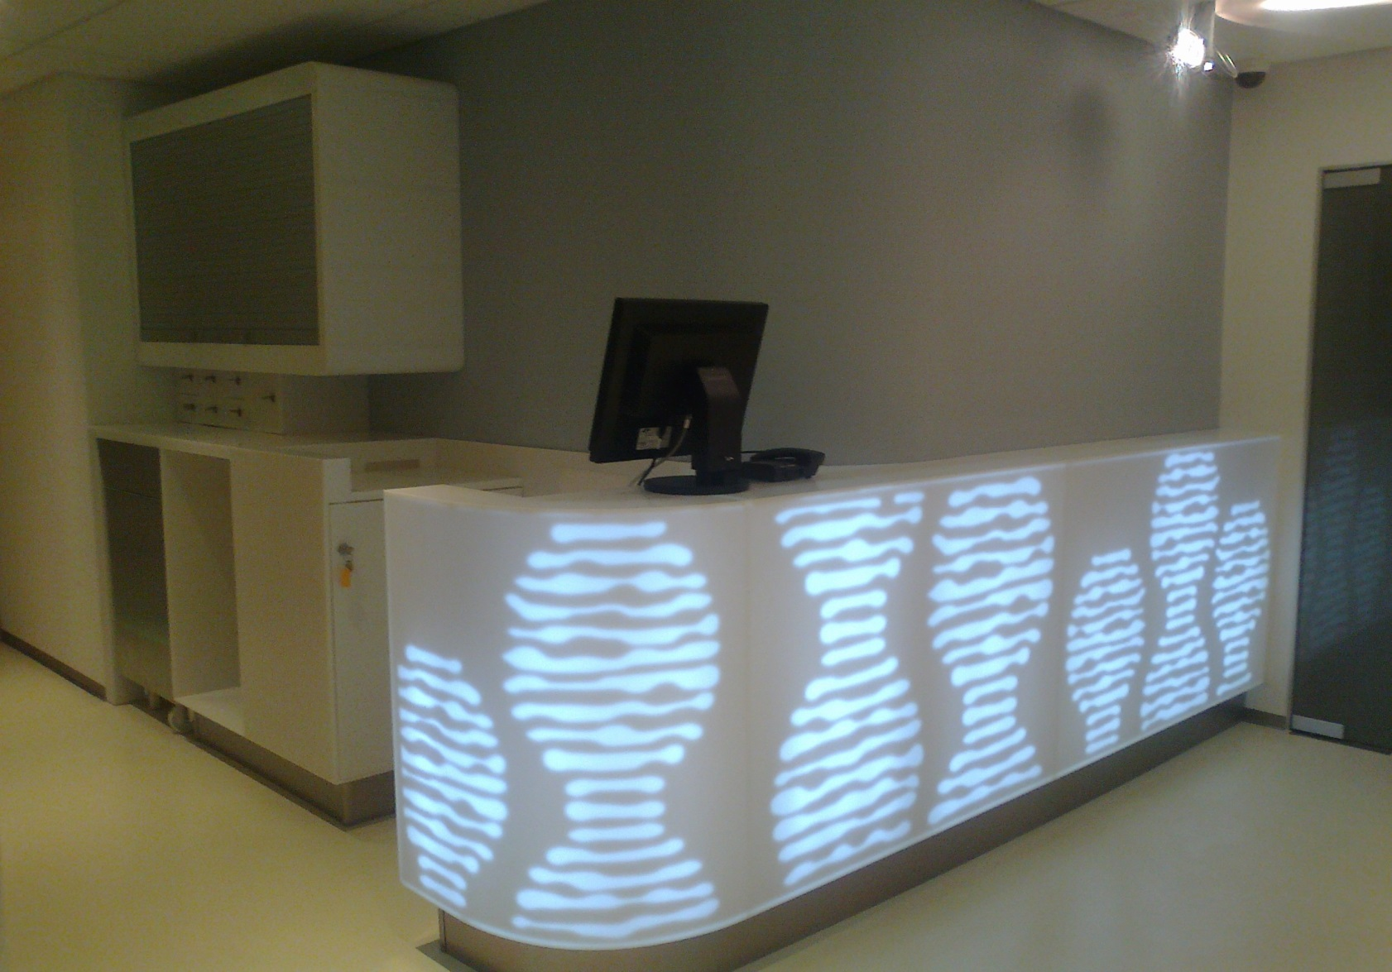
Hotel industry
Hilton – wellness center reception

Slide 17
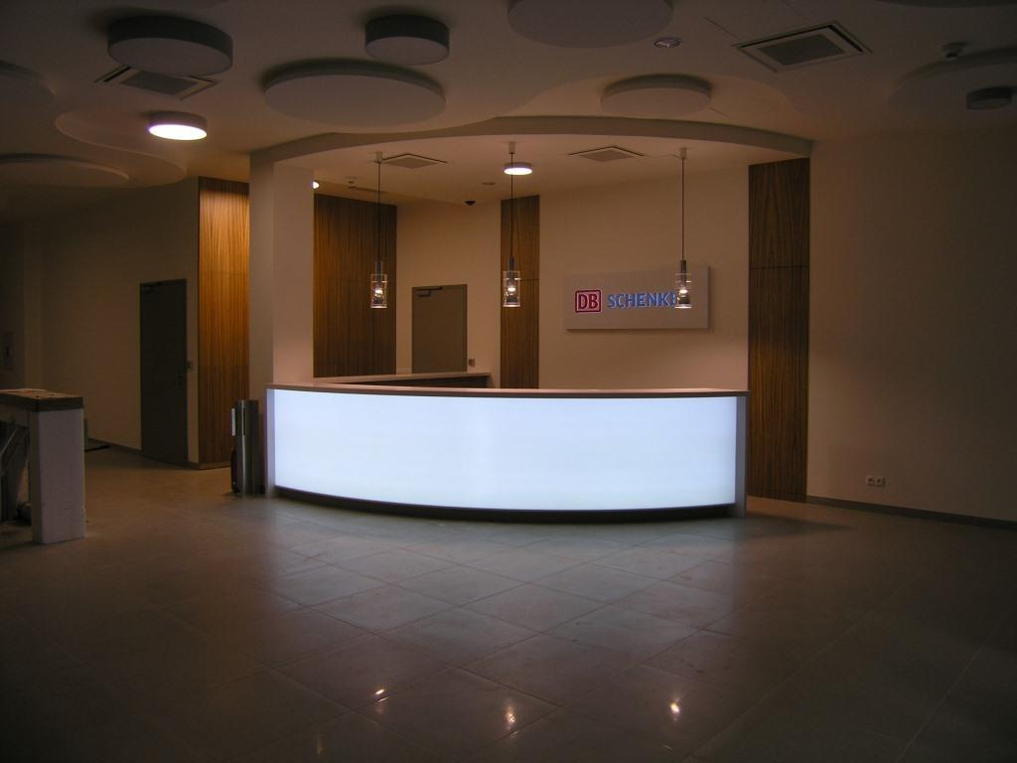
Schenker – reception desk TL

Slide 18
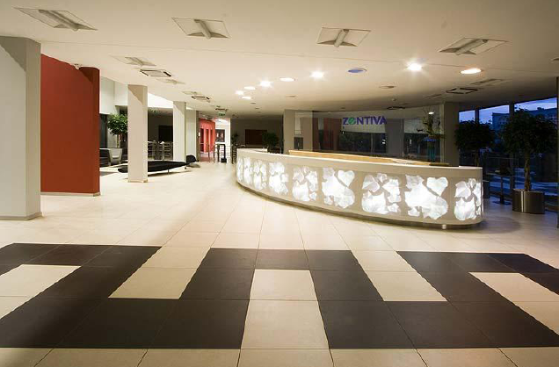
Central Pharmacy Czech Republic
Zentiva

Slide 19
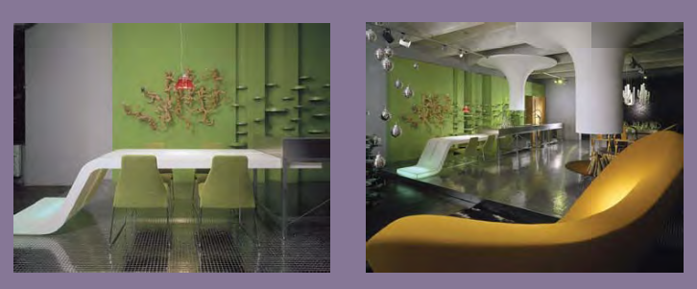
Helath care
Massage center

Slide 20
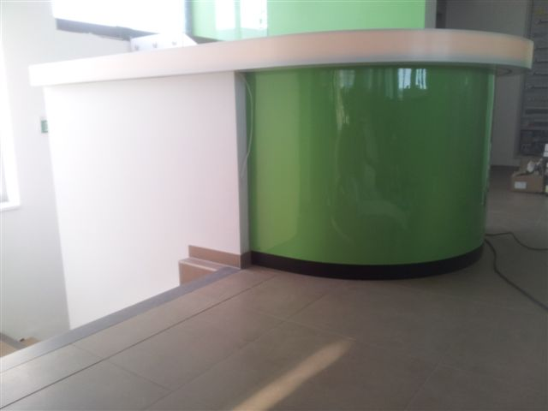
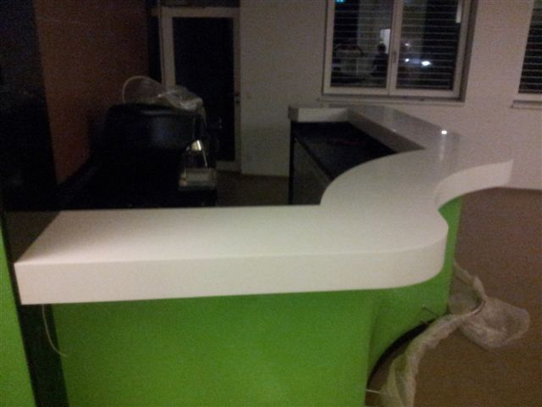
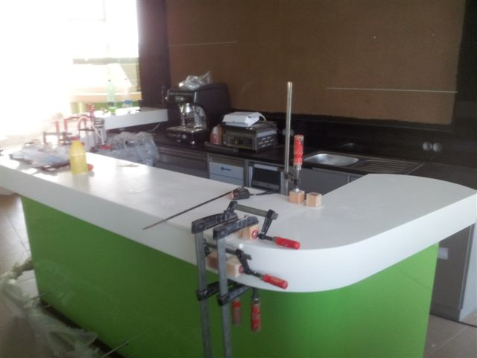
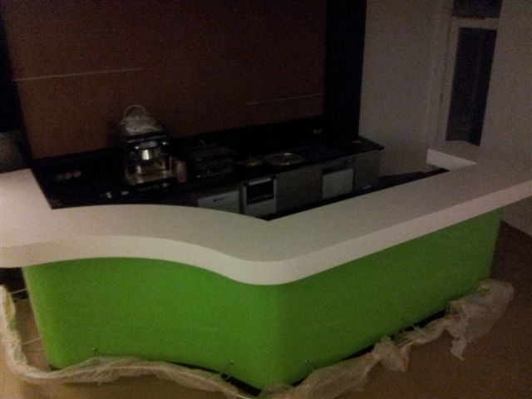

Healthcare center
Graz-austria

Slide 21







Dining tables

Slide 22





Kitchen worktops

Slide 23

In your daily life
Just use your imagination

